Slide 1

Code As Long As You Speak English By Shakila Tayefeh Alzahra University May 2019

Slide 2

• What is a “Programming Language”? • Why are all progrmming languages in English? • Do people in non-English-speaking countries code in English? • Are there any non-English-based programming languages?

Slide 3
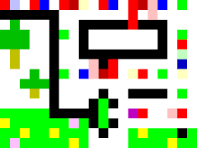
• A programming language is a vocabulary and set of grammatical rules for instructing a computer or computing device to perform specific tasks. The term programming language usually refers to high-level languages, such as BASIC, C, C++ and Java. • Each programming language has a unique set of keywords (words that it understands) and a special syntax for organizing program instructions.

Slide 4
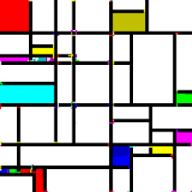
• Out of the 8,500+ programming languages recorded, roughly 2,400 of them were developed in the United States, 600 in the United Kingdom, 160 in Canada, and 75 in Australia.
• In other words, over a third of all programming languages were developed in a country with English as the primary language.

Slide 5

YES!

Slide 6
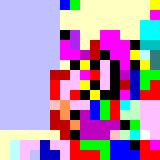
The answer is YES!

Slide 7

• Аналитик • Эл-76 • Dolittle • AMMORIA • Drama • Mama • DRAKON • Farsinet • Linotte • Simorgh(SPL)

Slide 8
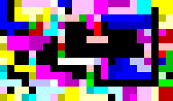
Esoteric Programming Languages
An esoteric programming language is a programming language designed to test the boundaries of computer programming language design, as a proof of concept, as software art, as a hacking interface to another language, or as a joke.

Slide 9
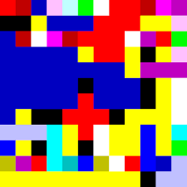
• Beatnik • Ook • Piet • Mycelium • Blub • Chef • Chicken • CopyPasta • DNA#

Slide 10
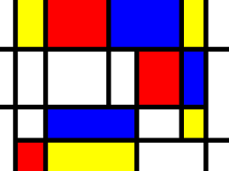
Special thanks to Golnaz Bahrami

